Slide 1
WAY TO VIDYA (An app)
-4Cause (Team 10)
Bhavana Kuntal
Amit Singh
Avijit Parnami
G.Sreedurga

Slide 2
What is this app all about?
This app would try to solve one of the most prevalent problems of youth-’Counselling regarding education’.
Many students are not enough privileged to consult any education consultation.
In this advanced world of smart phones,An app would definitely be a proper medium to educate students about various streams of education.

Slide 3
Basically , Most of the students in our country today are unaware of the vast domain of education and are mislead into those streams which they are not passionate about!
Even the education system in our India is so biased towards few subjects and in this process of studies , true talent of students remain unnoticed.

Slide 4
DO YOU KNOW?
Only 35% of the literate Indians know about Fashion Technology and institutes like NIFT and NID.
Most of us didn’t know the existence of a branch called oceonaography.
Southern states have only Maths,Physics,chemistry,Economics and commerce as their subjects after 10th.

Slide 5
Examples of few unleashed branches:
Fashion technology
Bio informatics
Bakery management
Fat studies
Bowling industry management
Criminal psychology
Oceonography
Epistemology
Ethics and political philosophy
Sabermetrics(statistical analysis)

Slide 6
Being students, We have experienced this problem . So ,when we got this topic of discussion during NCAT course, we felt an app would make a good solution to it.
This app would try to unleash and present many unknown and creative branches of education before youth.
Thereby this would try to help the student realize what is their passion and helps them by providing a list of all the professions related to it.
This would also give examples of successful individuals in various professions that makes student feel secured and confident that they have fair chances to succeed in this unpopular professions too!

Slide 7
Our app basically can be executed using various sorting algorithms:
1)Based on age : If you enter the age, This app would show you all those options you have further.
2)Based on interest : If you chose the field , you would get list of all professions related to it.
3)Based on intersections of multiple fields: If you are interested in multiple fields , it would provide you with a list of professions which need all of them(if they exist).

Slide 8
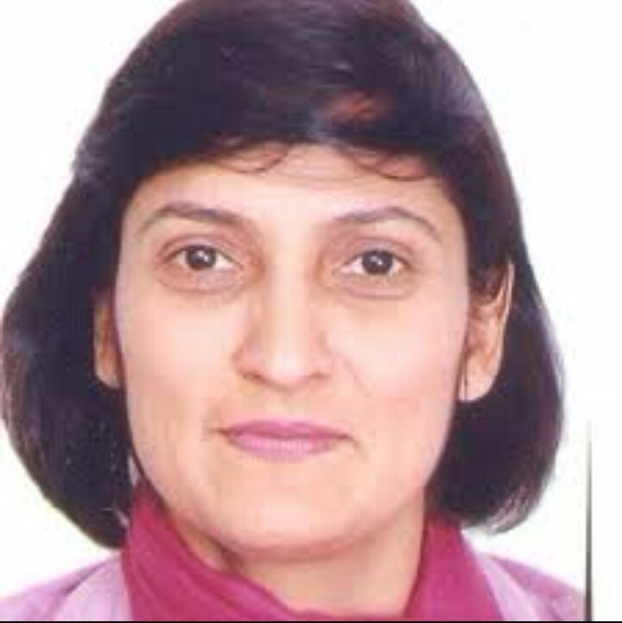
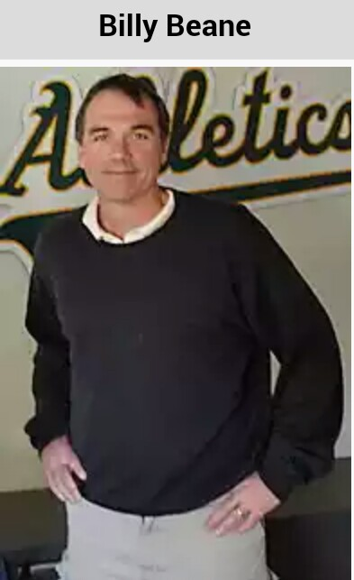
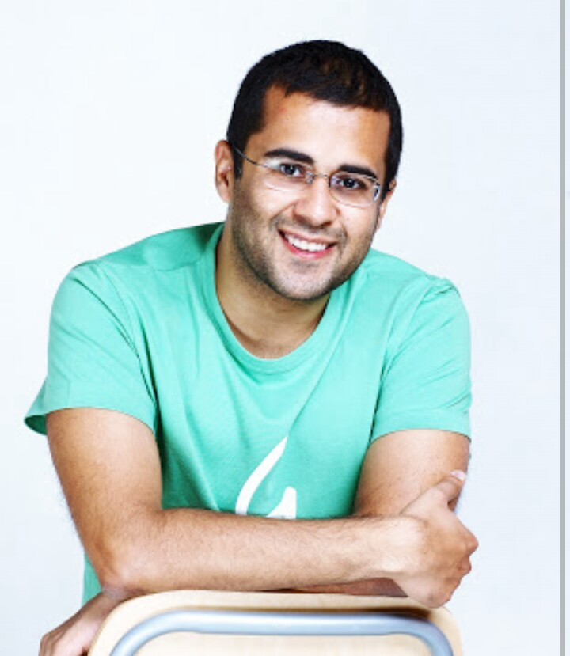
Ms.Sunaina Tomar,NIFT Director General
Billy Beane,Sa-bermetrist
Chetan Bhagat,famous writer

Slide 9
Marketing:
To promoting about this app , We feel the best medium would definitely be play store . When the children are using some other app, this advertisement may drag their attention easily because it will definitely sound interesting to them.
This would also be promoted in schools because the target group of this app is mainly youth and students.

Slide 10
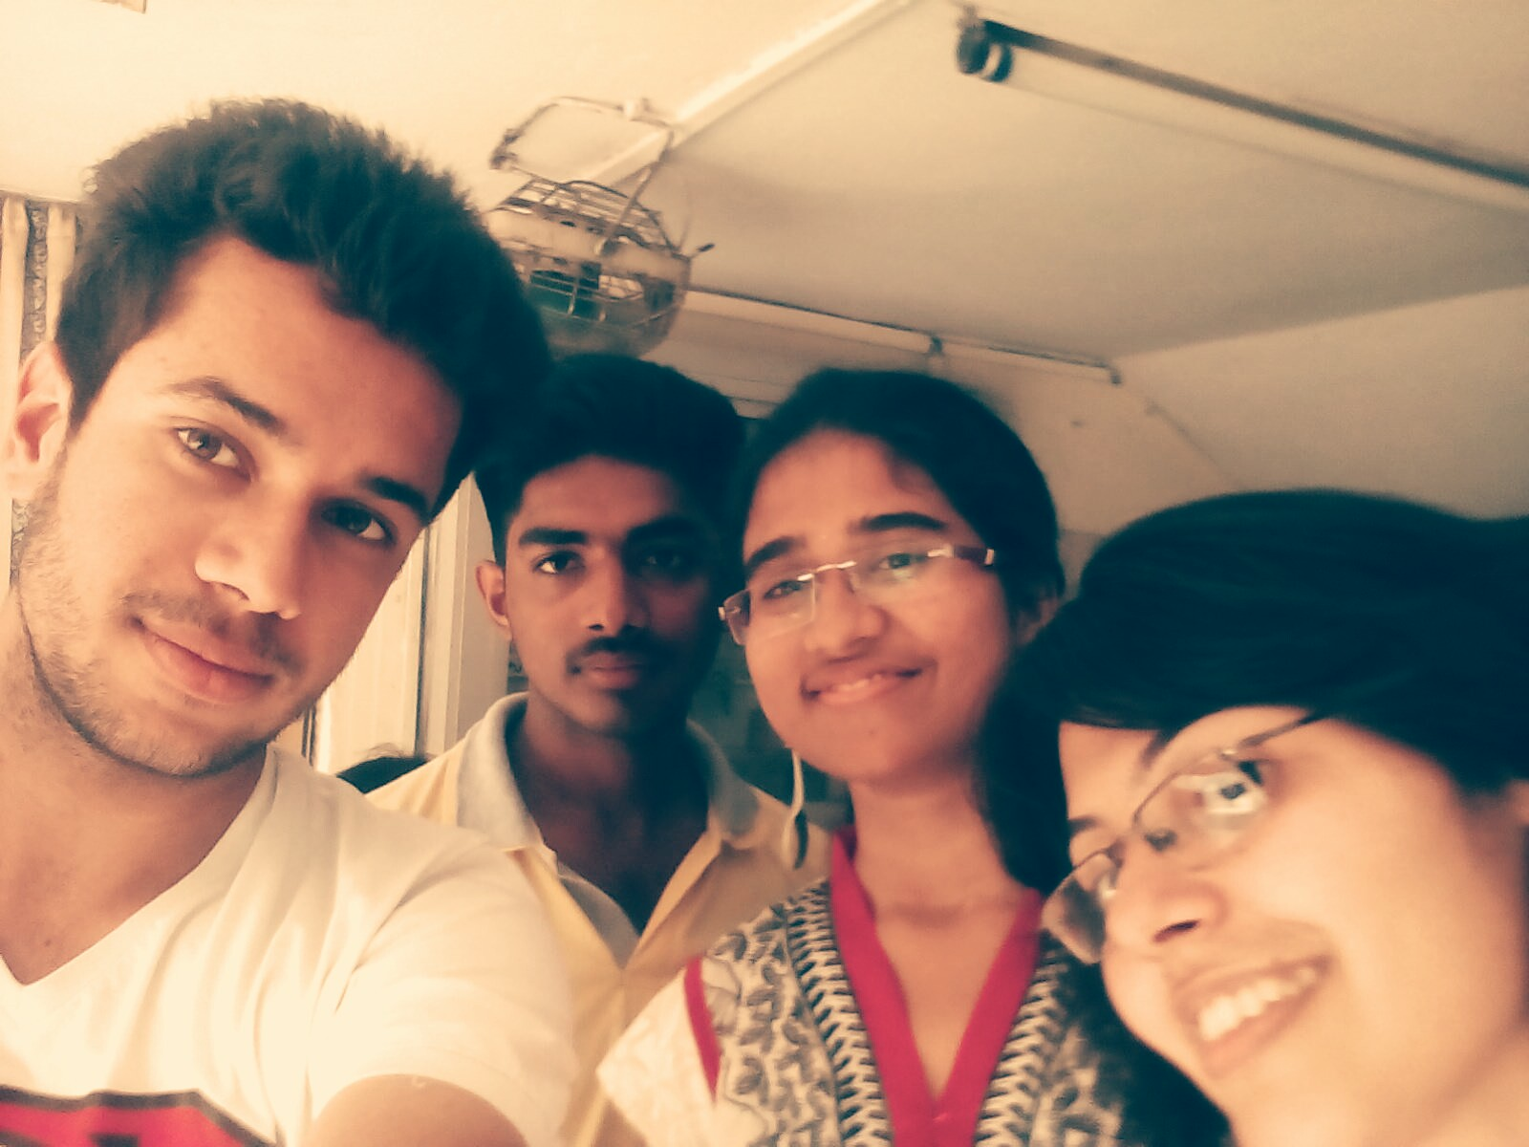
THANK YOU!
We sincerely thank NCAT and audience for giving us this opportunity.
-

